Slide 1
Initial Results of the POSITIVE (Pregnancy Outcome and Safety of Interrupting Therapy for women with endocrine responsIVE breast cancer) Trial
Ann H. Partridge, MD, MPH
Dana-Farber Cancer Institute, Boston, MA
Olivia Pagani, MD
International Breast Cancer Study Group (IBCSG), Bern, Switzerland

Slide 2
Future Fertility is of Paramount Importance for Young Breast Cancer Patients and Survivors
Many young breast cancer patients and survivors desire pregnancy
There have been concerns that a pregnancy might increase the risk of an early-stage breast cancer coming back, particularly in the setting of hormone receptor-positive breast cancer
Prior studies looking back in registries and databases have shown that pregnancy after BC does not worsen disease outcomes, regardless of hormone receptor status
Standard 5-10 years of adjuvant endocrine therapy compromises conception in women with hormone receptor-positive disease

Slide 3
The POSITIVE Trial was Designed to Address this Clinical Conundrum
First international, prospective, single-arm trial to address the question: is it safe, from a breast cancer relapse perspective, to temporarily interrupt endocrine therapy (ET) to attempt pregnancy?
Study designed with protocol for specific inclusion and safety criteria

Slide 4
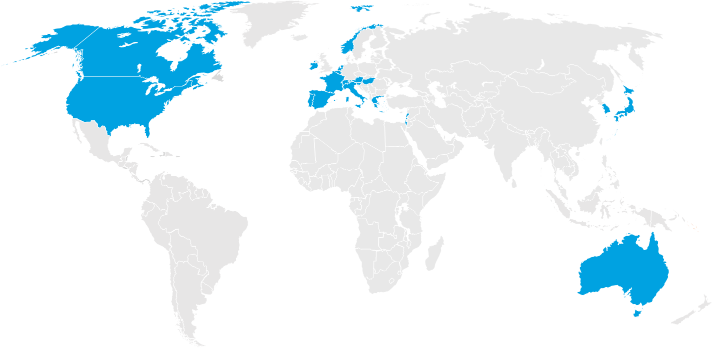
Trial enrollment (Dec 2014 - Dec 2019)
Foundation for International Cancer Research
116 centers
Across 20 countries
On 4 continents
North America 117 pts (23%)
Europe 317 pts (61%)
POSITIVE POPULATION: 516 patients
Median age 37 years
75% no prior births
94% stage 1 or 2
62% received chemo
Asia/Pacific/ Middle-East 84 pts (16%)
Median time from BC diagnosis to enroll.: 29 mos
Median follow-up: 41 months

Slide 5
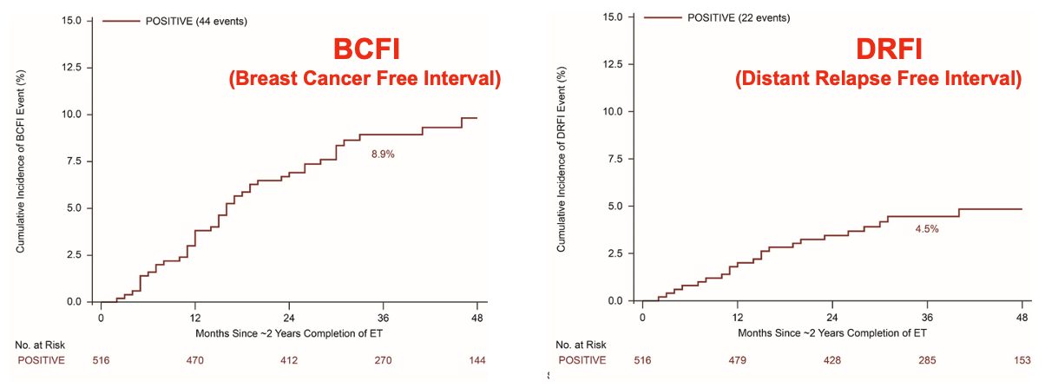
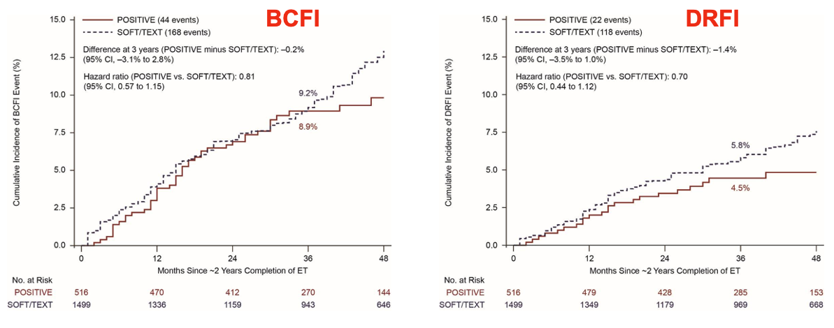
Breast Cancer Outcomes
POSITIVE Cohort
➔
POSITIVE
vs.
TEXT/SOFT
Cohort
➔

Slide 6
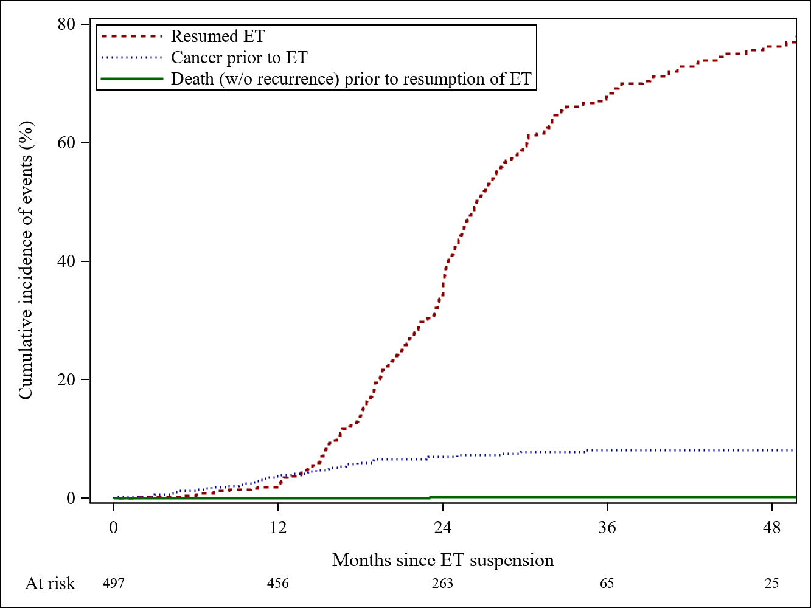
ET Resumption: Competing Risk Analysis
Cumulative incidences at 48 months:
8% had cancer recurrence/death (9 deaths) before resuming ET
76% resumed ET
15% had not yet resumed ET 79% of women disease-free at 2 years who have not yet resumed ET reported continuing pursuit of pregnancy, active/recent pregnancy or breastfeeding at most recent follow-up.

Slide 7
Pregnancy and Offspring Outcomes
368 (74%) of 497 women had at least one pregnancy (70% within 2 years) with a total of 507 pregnancies
317 had at least one live birth (64% of all women, 86% of those who became pregnant)
19% had at least one miscarriage
3% had at least one abortion
8% of offspring were low birth weight and 2% had birth defects

Slide 8
Conclusions - Initial results of the POSITIVE Trial
Temporary interruption of endocrine therapy to attempt pregnancy among young breast cancer survivors is safe in short-term follow-up
Most women (74%) had at least one pregnancy, most (70%) within 2 years
Birth defects were low (2%), not clearly associated with treatment exposure
Long-term follow-up both to monitor ET resumption and disease outcomes
These data stress the need to incorporate patient-centered reproductive healthcare in the care of young women with breast cancer

Slide 9
We THANK YOU…
Foundation for International Cancer Research
All our patients and their families
The Investigators, Data Mangers, Study nurses and Pathologists at the Participating Centers
The Collaborative Groups and their Collaborators
The Trial Coordinators, Data Managers, Monitors and Collaborators at the IBCSG Offices.
The current and former Members of the IBCSG Data Safety and Monitoring Committee (DSMC) and the POSITIVE Steering Committees
All our supporters: national funding bodies, charities and private donors

Slide 10
Disclosure Information Press Conference | San Antonio Breast Cancer Symposium 2022
Ann Partridge
I have the following relevant financial relationships to disclose: Receive royalties from UpToDate
Olivia Pagani
None

