Slide 1
Trastuzumab deruxtecan versus trastuzumab emtansine in patients with
HER2-positive metastatic breast cancer: Updated results of the randomized, phase 3 study DESTINY-Breast03
Sara A. Hurvitz, MD
Department of Medicine, David Geffen School of Medicine, University of California, Los Angeles and Jonsson Comprehensive Cancer Center, Los Angeles, CA, USA

Slide 2
Disclosure Information Press Conference | San Antonio Breast Cancer Symposium 2022
Sara A. Hurvitz, MD
I have the following relevant financial relationships to disclose:
Grant/Research support paid to institution from: Ambrx, Amgen, AstraZeneca, Arvinas, Bayer, Daiichi Sankyo, CytomX, Dantari, Dignitana, G1 Therapeutics, Genentech/Roche, Gilead, GSK, Immunomedics, Eli Lilly, Macrogenics, Novartis, Pfizer, OBI Pharma, Phoenix Molecular Designs, Orinove, Pieris, PUMA, Radius, Samumed, Sanofi, SeaGen, Zymeworks
Honoraria from: Daiichi Sankyo
Stockholder (spouse) in: Ideal Implant

Slide 3
2L Treatment for HER2-Positive Breast Cancer
1L, first-line; 2L, second-line; 2L+, second-line and beyond; BICR, blinded independent central review; HER2, human epidermal growth factor receptor 2; HR, hazard ratio; mPFS, median progression-free survival; NR, not reached; PFS, progression-free survival; T-DM1, trastuzumab emtansine; T-DXd, trastuzumab deruxtecan.
1. Swain SM et al. N Engl J Med. 2015;372(8):724-734. 2. Perez J et al. Expert Opin Biol Ther. 2021;21:811-24. 3. Verma S et al. N Engl J Med. 2012;367:1783-91. 4. Gennari A et al. Ann Oncol. 2021;32:1475-1495. 5. FDA Press Release. FDA grants regular approval to fam-trastuzumab deruxtecan-nxki for breast cancer. May 4, 2022. https://www.fda.gov/drugs/resources-information-approved-drugs/fda-grants-regular-approval-fam-trastuzumab-deruxtecan-nxki-breast-cancer. 6. Cortes J et al. N Engl J Med. 2022;386:1143-1154.

Slide 4
Updated OS Analysis of DESTINY-Breast03
Randomized, open-label, multicenter phase 3 study (NCT03529110)
The prespecified OS interim analysis was planned with 153 events.^{d} At the time of data cutoff (July 25, 2022),
169 OS events were observed and the P value to achieve statistical significance was 0.013
BICR, blinded independent central review; DoR, duration of response; HER2, human epidermal growth factor receptor 2; IHC, immunohistochemistry; ISH, in situ hybridization; ORR, objective response rate; OS, overall survival; PFS, progression-free survival; Q3W, every 3 weeks; R, randomization; T-DM1, trastuzumab emtansine; T-DXd, trastuzumab deruxtecan.
ªHER2 IHC 3+ or IHC 2+/ISH+ based on central confirmation. ^{b}Progression during or within 6 months after completing adjuvant therapy involving trastuzumab and a taxane. ^{c}80% powered at 2-sided significance level of 5%. ^{d}Information fraction of 61%, with a P value boundary to reach statistical significance of 0.008. The P value was recalculated based on the actual OS events at the data cutoff.

Slide 5
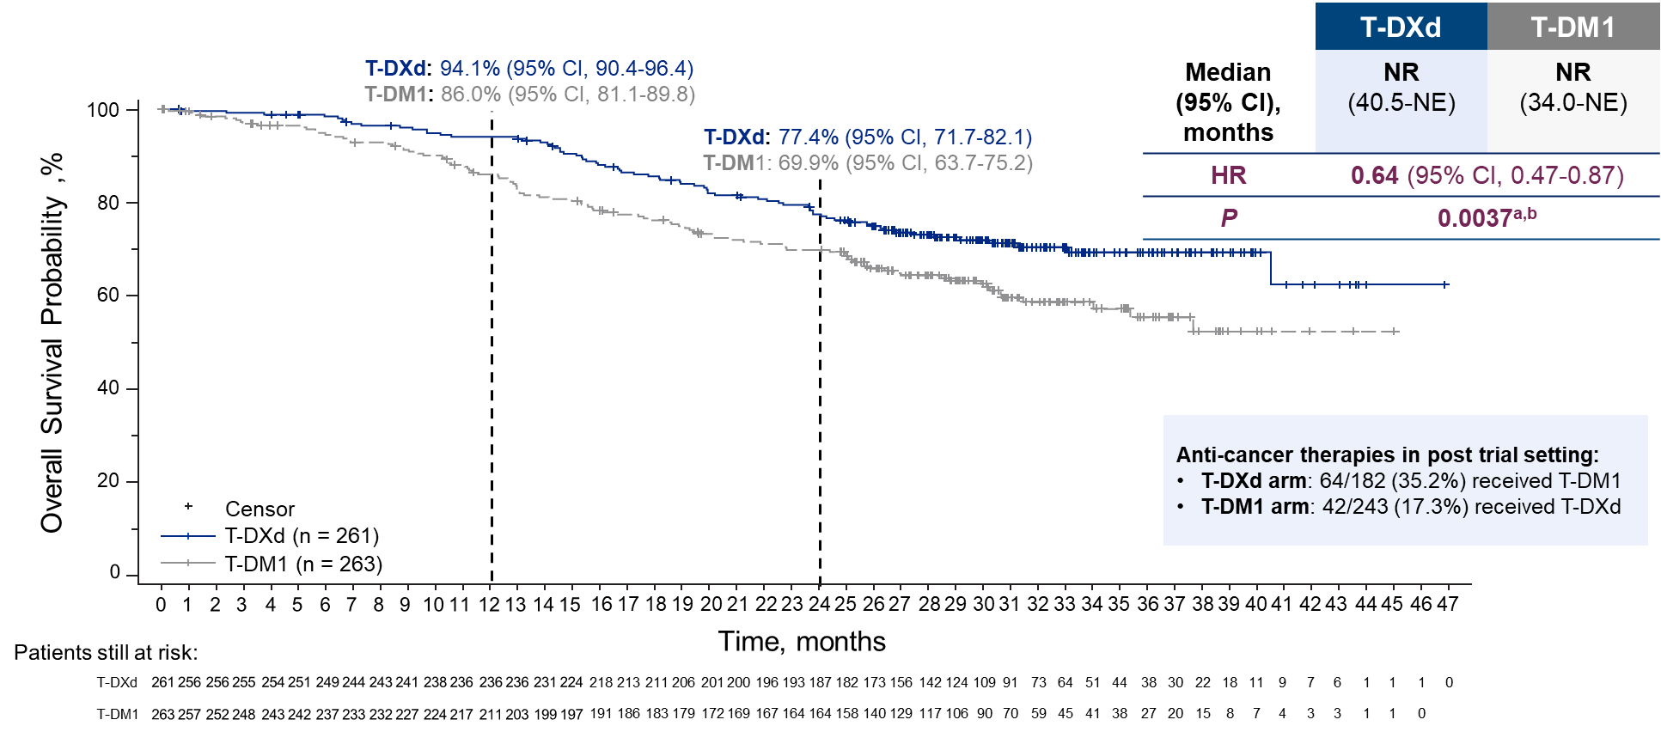
Key Secondary Endpoint: Overall Survival
HR, hazard ratio; mOS, median overall survival; NE, not estimable; NR, not reached; T-DM1, trastuzumab emtansine; T-DXd, trastuzumab deruxtecan.
There were 19 patients (7.3%) treated with T-DXd and 28 patients (10.6%) treated with T-DM1 who were lost to follow-up.
ªThe P value for overall survival crossed the prespecified boundary (P = 0.013) and was statistically significant. ^{b}Two-sided from stratified log-rank test.

Slide 6
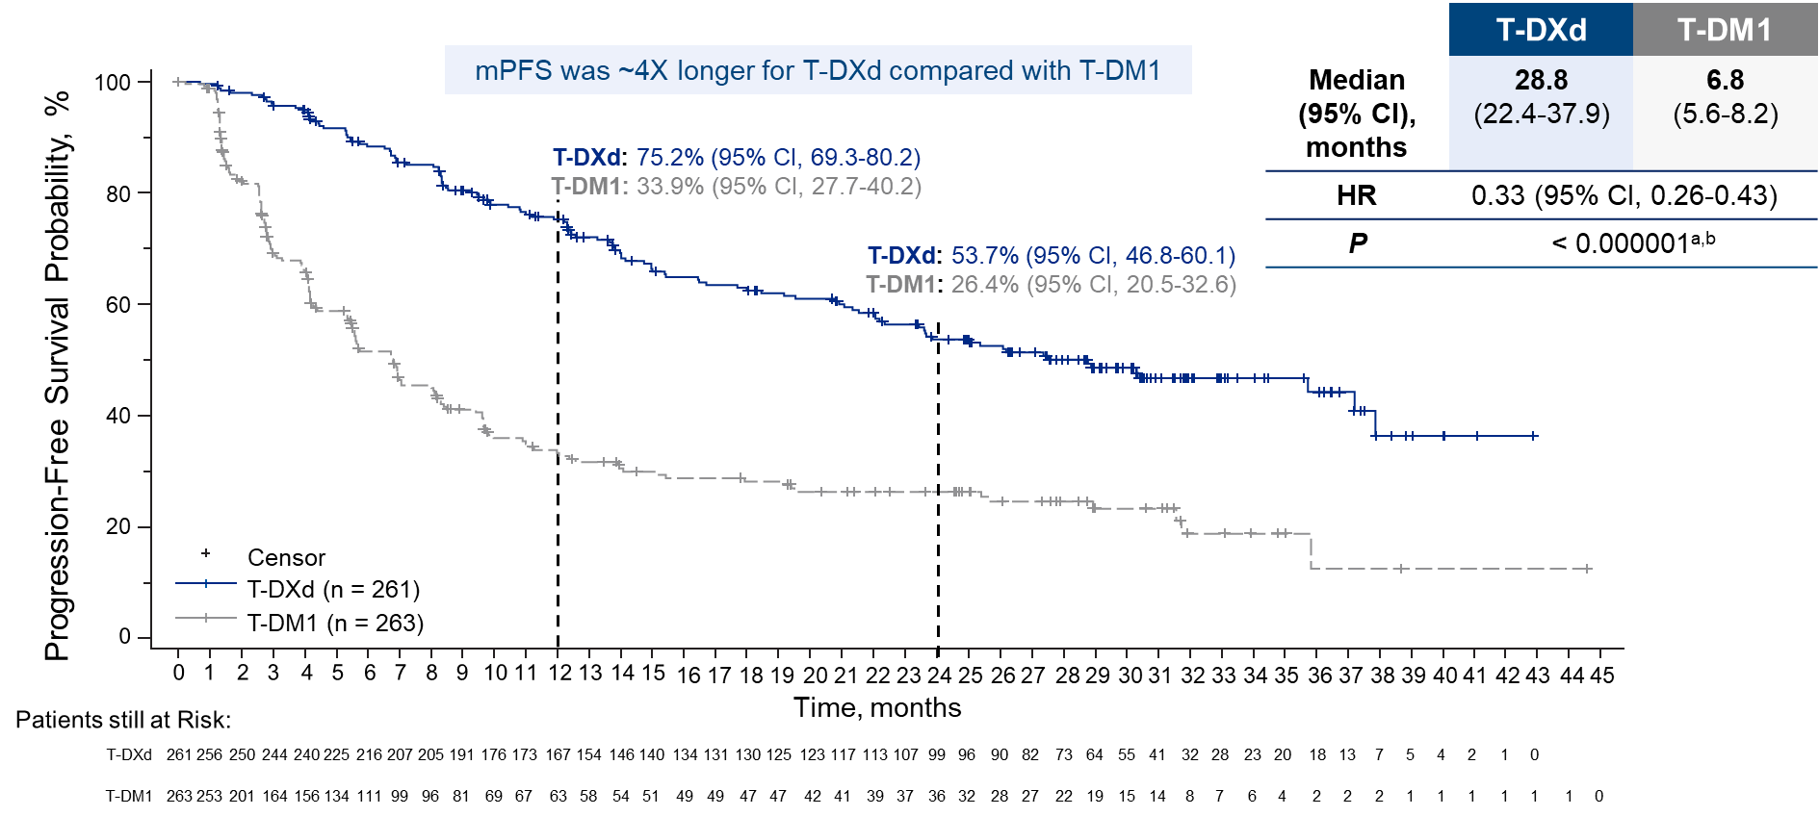
Updated Primary Endpoint: PFS by BICR
BICR, blinded independent central review; HR, hazard ratio; mo, month; mPFS, median progression-free survival; PFS, progression-free survival; T-DM1, trastuzumab emtansine; T-DXd, trastuzumab deruxtecan.
ªTwo-sided, from stratified log-rank test. ^{b}Nominal P value.

Slide 7
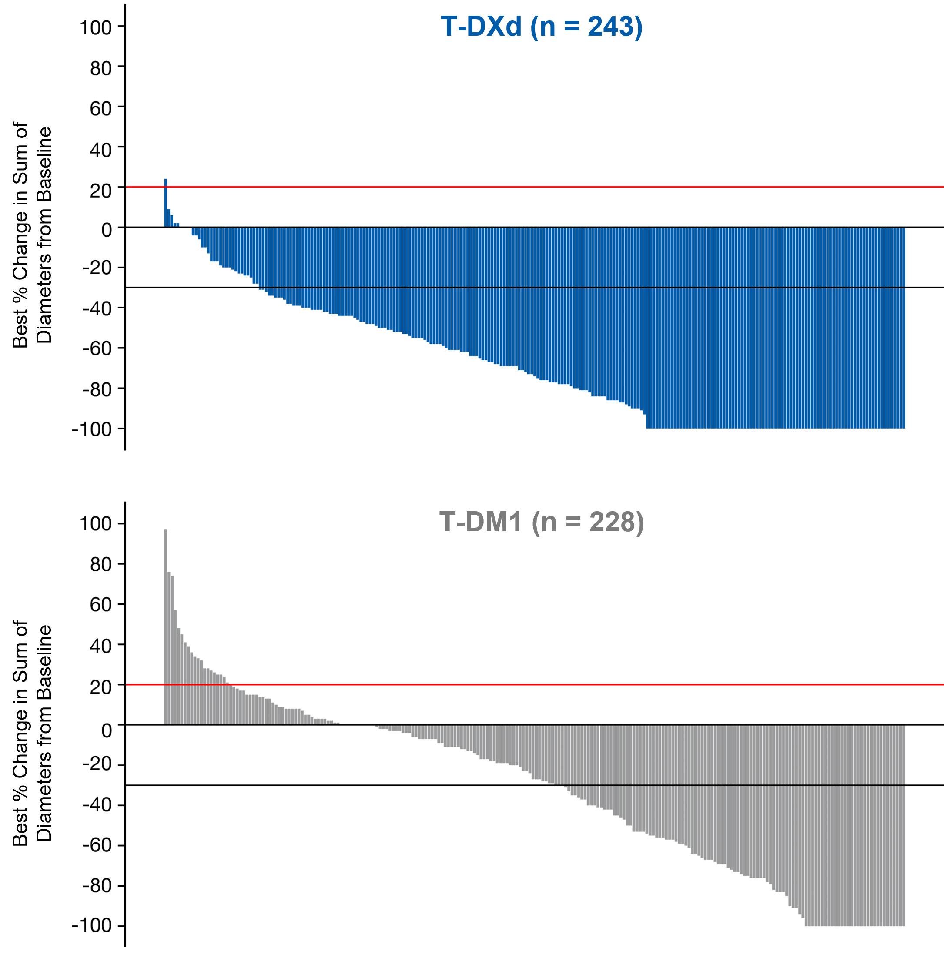
Confirmed ORR and Other Efficacy Endpoints
 | T-DXd | T-DM1
 | n = 261ª | n = 263ª
Confirmed ORR by BICR
n (%) | 205 (78.5) | 92 (35.0)
[95% CI] | [73.1-83.4] | [29.2-41.1]
Nominal P value | < 0.0001
CR, n (%) | 55 (21.1) | 25 (9.5)
PR, n (%) | 150 (57.5) | 67 (25.5)
SD, n (%) | 47 (18.0) | 110 (41.8)
PD, n (%) | 3 (1.1) | 47 (17.9)
NE, n (%) | 6 (2.3) | 14 (5.3)
CBR, n (%) [95% CI] | 233 (89.3) [84.9-92.8] | 122 (46.4) [40.2-52.6]
Nominal P value | < 0.0001
mDoR by BICR, months (95% CI) | 36.6 (22.4-NE) | 23.8 (12.6-34.7)
BICR, blinded independent central review; CBR, clinical benefit rate; CR, complete response; mDoR, median duration of response; NE, not evaluable; ORR, objective response rate; PD, progressive disease; PR, partial response; SD, stable disease; T-DM1, trastuzumab emtansine; T-DXd, trastuzumab deruxtecan.
Red line at 20% indicates progressive disease; black line at −30% indicates partial response.
ªOnly patients with measurable disease at baseline and at least 1 postbaseline target lesion assessment were included.

Slide 8
Overall Safety Summary
Type of Adverse Event, n (%) | T-DXd n = 257 | T-DM1 n = 261
Any-grade TEAE Drug related | 256 (99.6) 252 (98.1) | 249 (95.4) 228 (87.4)
Grade ≥3 TEAEs Drug related | 145 (56.4) 121 (47.1) | 135 (51.7) 110 (42.1)
Serious TEAEs Drug related | 65 (25.3) 33 (12.8) | 58 (22.2) 20 (7.7)
TEAEs associated with drug discontinuation Drug related | 55 (21.4) 51 (19.8) | 24 (9.2) 17 (6.5)
TEAEs associated with dose reduction Drug related | 66 (25.7) 65 (25.3) | 38 (14.6) 38 (14.6)
TEAEs associated with drug interruption Drug related | 136 (52.9) 108 (42.0) | 76 (29.1) 45 (17.2)
TEAEs associated with an outcome of death Drug related | 6 (2.3) 0 | 6 (2.3) 0
Adjudicated, drug related ILD/pneumonitis Grade 4/5 | 39 (15.2) 0 | 8 (3.1) 0
Median treatment duration:
T-DXd: 18.2 mo (range, 0.7-44.0)
T-DM1: 6.9 mo (range, 0.7-39.3)
The most common TEAEs were:
T-DXd: nausea (77.0%), vomiting (51.8%), and alopecia (39.7%)
T-DM1: platelet count decreased (43.7%), aspartate aminotransferase increased (41.4%), and nausea (30.3%)
Any-grade ILD/pneumonitis rate:
T-DXd: 15.2%
T-DM1: 3.1%
ILD, interstitial lung disease; mo, month; T-DM1, trastuzumab emtansine; T-DXd, trastuzumab deruxtecan; TEAE, treatment-emergent adverse event.
Relationship to study drug was determined by the treating investigator.

Slide 9
Conclusions
T-DXd demonstrated clinically meaningful and statistically significant improvement in OS over T-DM1, as well as continued PFS benefit, in patients previously treated with trastuzumab and a taxane
T-DXd significantly reduced the risk of death by 36% (HR, 0.64)
mPFS with T-DXd was 4 times longer than with T-DM1 (28.8 months vs 6.8 months)
78.5% of patients experienced a confirmed objective response; 1 in 5 (21.1%) experienced a CR
With a longer treatment duration, T-DXd continues to demonstrate a manageable and tolerable safety profile
There were similar rates of grade ≥3 TEAEs with T-DXd and T-DM1
There were no grade 4 or 5 adjudicated drug-related ILD/pneumonitis events
Updated results demonstrate remarkable OS and PFS benefit with T-DXd, further supporting the use of T-DXd as the second-line standard of care in patients with HER2-positive mBC

Slide 10
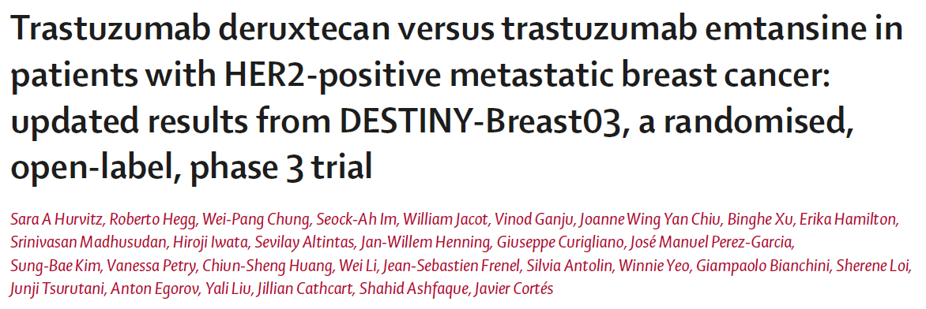
Accompanying Manuscript Published in The Lancet

