Slide 1
Camizestrant, a next-generation oral SERD vs fulvestrant in post-menopausal women with advanced ER-positive HER2-negative breast cancer: Results of the randomized, multi-dose Phase 2 SERENA-2 trial
Mafalda Oliveira, MD, PhD¹, Denys Pominchuk, PhD², Zbigniew Nowecki MD³, Erika Hamilton, MD⁴, Yaroslav Kulyaba, MD⁵,Timur Andabekov, PhD⁶, Yevhen Hotko, MD⁷, Tamar Melkadze, MD⁸, Gia Nemsadze, MD, PhD⁹, Patrick Neven, MD¹⁰, Yuriy Semegen, MD¹¹, Vladimir Vladimirov, MD¹², Claudio Zamagni, MD¹³, Hannelore Denys, MD, PhD¹⁴, Frédéric Forget, MD¹⁵, Zsolt Horvath, MD, PhD¹⁶, Alfiya Nesterova, MD, PhD¹⁷, Maxine Bennett, PhD¹⁸, Bistra Kirova, MBChB, MSc¹⁹, Teresa Klinowska, PhD²⁰, Justin P O Lindemann, MBChB, MB¹⁸, Delphine Lissa, PharmD, PhD¹⁸, Alastair Mathewson, PhD¹⁸, Christopher J Morrow, PhD¹⁸, Zuzana Traugottova, MD²¹, Ruaan van Zyl, PhD²², Ekaterine Arkania, MD²³
¹Medical Oncology Department, Vall d’Hebron University Hospital and Breast Cancer Group, Vall d'Hebron Institute of Oncology, Barcelona, Spain; ²Medical Center Verum, Kyiv, Ukraine; ³The Maria Sklodowska Curie Memorial Cancer Center and Institute of Oncology, Warsaw, Poland; ⁴Sarah Cannon Research Institute/Tennessee Oncology, Nashville, TN, USA; ⁵Makiivka City Hospital of Donetsk Region, Makiivka, Ukraine; ⁶AV Medical Group, St Petersburg, Russian Federation; ⁷Central City Hospital, Uzhgorod National University, Uzhgorod, Ukraine; ⁸Oncology and Hematology Department, Academician Fridon Todua Medical Center – Research Institute of Clinical Medicine Tbilisi, Georgia; ⁹The Institute of Clinical Oncology, Tbilisi, Georgia; ¹⁰Multidisciplinary Breast Center, University Hospitals Leuven – Campus Gasthuisberg, Leuven, Belgium; ¹¹Bukovynsky Clinical Oncology Center, Chernivtsi, Ukraine; ¹²Pyatigorsky Oncology Dispensary, Pyatigorsk, Russia; ¹³IRCCS Azienda Ospedaliero-Universitaria di Bologna, Bologna, Italy; ¹⁴Department of Medical Oncology, Ghent University Hospital, Belgium; ¹⁵Centre Hospitalier de l'Ardenne-Site de Libramont, Libramont-Chevigny, Belgium; ¹⁶Center of Oncoradiology, Bács-Kiskun County Teaching Hospital, Kecskemét, Hungary; ¹⁷Republican Clinical Oncology Dispensary of the Ministry of Health of the Republic of Tatarstan, Russian Federation; ¹⁸Research and Early Development, Oncology R&D, AstraZeneca, Cambridge, UK; ¹⁹Oncology Patient Safety, Oncology R&D, AstraZeneca, Cambridge, UK; ²⁰Late Development, Oncology R&D, AstraZeneca, Cambridge, UK; ²¹Parexel International, Prague, Czech Republic; ²²Parexel International, Bloemfontein, South Africa; ²³Helsicore Israeli Georgian Medical Research Clinic, Tbilisi, Georgia.

Slide 2
Disclosure Information Press Conference | San Antonio Breast Cancer Symposium 2022
Mafalda Oliveira MD, PhD
I have the following relevant financial relationships to disclose:
Employee of: Vall d'Hebron University Hospital, Barcelona, Spain
Consultant for: AstraZeneca, Gilead, GSK, iTEOS, MSD, Pierre Fabre, Roche and SeaGen
Speaker’s Bureau for: AstraZeneca, Eisai, Novartis, Roche and SeaGen
Grant/Research support from: AstraZeneca, Boehringer-Ingelheim, Genentech, Gilead, GSK, Immunomedics, Novartis, Roche, SeaGen and Zenith Epigenetics

Slide 3
SERENA-2 study overview
SERENA-2 was designed to compare camizestrant 75 and 150 mg with fulvestrant​; it was not powered to compare camizestrant doses ​.
Primary analysis was triggered when 108 progression events (75% maturity) occurred in the best performing pair (camizestrant 75 or 150 mg vs fulvestrant)​. This provided 86% power at the 2-sided 10% significance level, assuming the true hazard ratio was 0.59 and the median PFS in the control arm was 5 months.
camizestrant 300 mg (n=20)
(CSP v5 amendment: 16Dec20)
Key inclusion/exclusion criteria:
Recurrence or progression on at least one line of ET
No prior fulvestrant or oral SERD in ABC
No more than one line of ET in ABC setting
No more than one line CT in ABC setting
Measurable and non-measurable disease
Post-menopausal ER+/HER2- ABC candidates to receive fulvestrant monotherapy in the ABC setting
Stratification:
Prior CDK4/6i
Lung/liver mets
camizestrant 75 mg (n=74)
R
1:1:1:1
N=240
camizestrant 150 mg (n=73)
fulvestrant (n=73)
Primary endpoint: PFS (investigator assessment*)
Secondary endpoints: CBR24, ORR, OS, safety
Translational endpoints: serial ctDNA analysis including ESR1m, serial CTCs analysis
*Disease progression assessed by the investigator and defined using RECIST, version 1.1
Primary analysis was triggered when 108 progression events occurred in best performing pair (camizestrant 75 or 150 mg vs fulvestrant)​. This provided 86% power at 2-sided 10% significance level, assuming true HR=0.59 and median PFS in control arm=5 months. SERENA-2 was designed to compare camizestrant 75 and 150 mg with fulvestrant​; it was not powered to compare camizestrant doses
ABC: advanced breast cancer; CBR24: clinical benefit rate at 24 weeks; CDK4/6i: CDK4/6 inhibitor; CT: chemotherapy; CTC: circulating tumor cells; ctDNA: circulating tumor DNA; ER: estrogen receptor; ​ ESR1m: mutation in estrogen receptor 1 gene; ET: endocrine therapy; HER2: human epidermal growth factor; PFS: progression-free survival; R: randomization; RECIST: Response Evaluation Criteria for Solid Tumors; SERD: selective estrogen receptor degrader ​

Slide 4
Key baseline patient characteristics
 | C 75 (n=74)​ | C 150 (n=73)​ | F (n=73)​ | Total (n=240)​
Age (median, range)​ | 61.0 (37-89) | 60.0 (42-84) | 60.0 (35-84) | 60.0 (35-89)
Gender, F (%)^{a​} | 100 | 100 | 100 | 100
Race, White (%)​ | 95.9 | 95.9 | 89.0 | 94.2
ER+ (%)​ | 100 | 100 | 100 | 100
PgR+ (%)​ | 81.1 | 84.9 | 79.5 | 79.6
ECOG 0 (%)​ | 62.2 | 57.5 | 58.9 | 58.8
Lung/liver metastasis Y (%) | 58.1 | 58.9 | 58.9 | 58.3
​Liver metastasis (%) | 31.1 | 41.1 | 47.9 | 40.8
Bone only disease (%) | 14.9 | 19.4 | 17.8 | 17.6
ESR1m detectable (%)^{b} | 29.7 | 35.6 | 47.9 | 36.7
D538G​ Y537N​ Y537S​ E380Q​ L536H​ Y537C​​ | 18.9 14.9 6.8 9.5 1.4 4.1 | 19.2 15.1 13.7 8.2 8.2 4.1 | 31.5 15.1 19.2 8.2 4.1 2.7 | 22.9 13.8 12.5 8.3 4.6 3.3
 | C 75 (n=74)​ | C 150 (n=73)​ | F (n=73)​ | Total (n=240)
CT adjuvant, Y (%)​ | 54.1 | 53.4 | 52.1 | 52.1
CT in ABC, Y (%)​ | 21.6 | 12.3 | 26.0 | 19.2
ET overall, lines (%)​ | ​ | ​ | ​ | ​
0​ | 1.4 | 1.4 | 0 | 0.8
1​ | 81.1 | 72.6 | 76.7 | 77.1
2​ | 16.2 | 24.7 | 19.2 | 20.0
3​ | 1.4 | 1.4 | 4.1 | 2.1
ET adjuvant, Y (%)​ | 66.2 | 71.2 | 60.3 | 66.7
AI​ SERM​ | 40.5 32.4 | 35.6 45.2 | 31.5 43.8 | 35.8 41.7
ET in ABC, lines (%)​ | ​ | ​ | ​ | ​
0​ | 37.8 | 28.8 | 26.0 | 31.3
1​ | 62.2 | 71.2 | 74.0 | 68.8
AI​ SERM | 55.4 6.8 | 67.1 2.7 | 67.1 6.8 | 63.3 5.0
Prior CDK4/6i Y (%)^{c} | 51.4 | 50.7 | 50.7 | 49.6
Palbociclib​ Ribociclib​ Abemaciclib | 21.6 23.0 5.4 | 31.5 19.2 1.4 | 30.1 16.4 4.1 | 27.9 18.3 3.8
ªAll post-menopausal women; ^{b}ESR1m assessed in plasma samples at screening (GuardantOMNI™) and Cycle 1 Day 1 (Guardant360®), ESR1m defined as E380Q, V422del, S463P, L536H/P/R, Y537C/D/N/S, D538G, individual mutations present in >2% total cases reported; ^{c}Missing or not specified in 3 patients ​
ABC: advanced breast cancer; AI: aromatase inhibitor; C: camizestrant; CDK4/6i: CDK4/6 inhibitor; CT: chemotherapy; ECOG: Eastern Cooperative Oncology Group; ER: estrogen receptor; ​​ ESR1m: mutation in estrogen receptor 1 gene; ET: endocrine therapy; F: female; PgR: progesterone receptor; SERM: selective estrogen receptor modulator (tamoxifen or toremifene) ​​

Slide 5
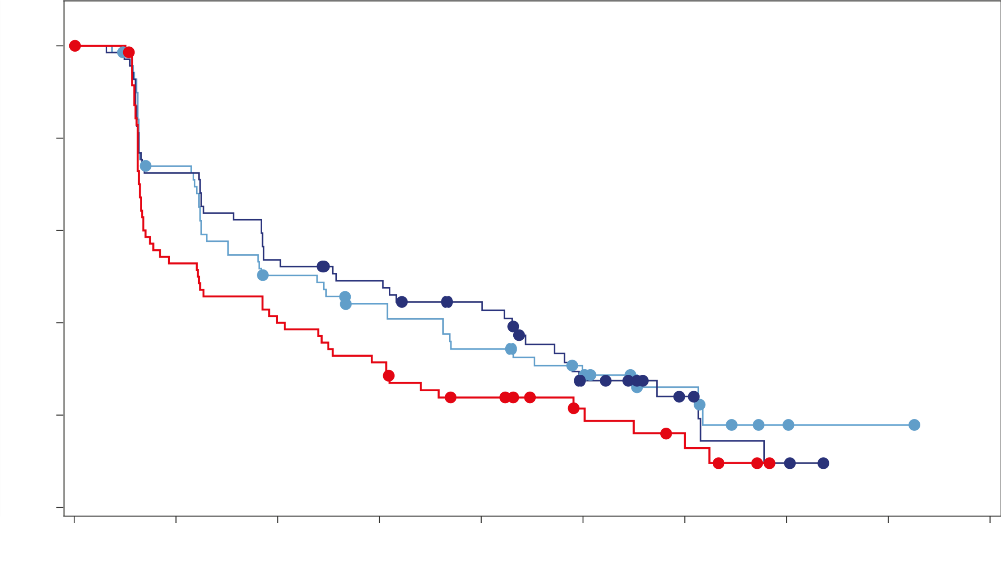
Primary endpoint: PFS by investigator assessment
 | C 75 (n=74) | C 150 (n=73) | F (n=73)
Median duration of follow-up, months​ | 16.6 | 16.6 | 17.4
Events [n (%)] | 50 (67.6) | 51(69.9) | 58 (79.5)
Median PFS, months (90% CI)​ | 7.2 (3.7-10.9) | 7.7 (5.5-12.9) | 3.7 (2.0-6.0)
Adjusted HR (90% CI)ª | 0.58 (0.41-0.81) | 0.67 (0.48-0.92) | -​
P value | 0.0124*​ | 0.0161*​ | -​
^{1.0}
In the overall population, camizestrant produces a statistically significant and clinically meaningful improvement in PFS for both 75 and 150 mg camizestrant doses over fulvestrant
BICR assessment conducted as a sensitivity analysis shows a statistically significant benefit in PFS at both doses of camizestrant over fulvestrant, consistent with the investigator assessment​
^{0.8}
^{0.6}
^{Probability of PFS}
^{0.4}
^{0.2}
^{Camizestrant 75 mg}
^{Camizestrant 150 mg}
^{Fulvestrant 500 mg}
^{0.0}
⁰
³
⁶
⁹
¹²
¹⁵
¹⁸
²¹
²⁴
²⁷
^{Time (months)}
C 75 | 74 | 50 | 33 | 27 | 21 | 14 | 7 | 2 | 1 | 0
C 150 | 73 | 50 | 37 | 32 | 25 | 12 | 6 | 2 | 0
F | 73 | 37 | 28 | 22 | 14 | 8 | 5 | 0
*Statistically significant; ªHRs adjusted for prior use of CDK4/6i and liver/lung metastases
BICR: blinded independent central review; CDK4/6i: CDK4/6 inhibitor; CI: confidence interval; HR: hazard ratio; PFS: progression-free survival

Slide 6
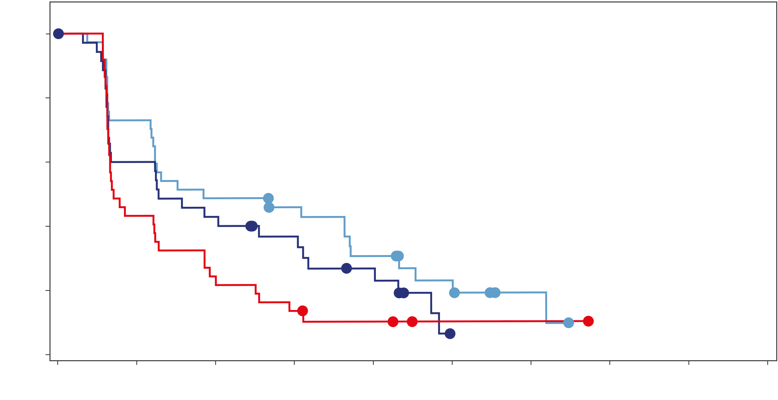
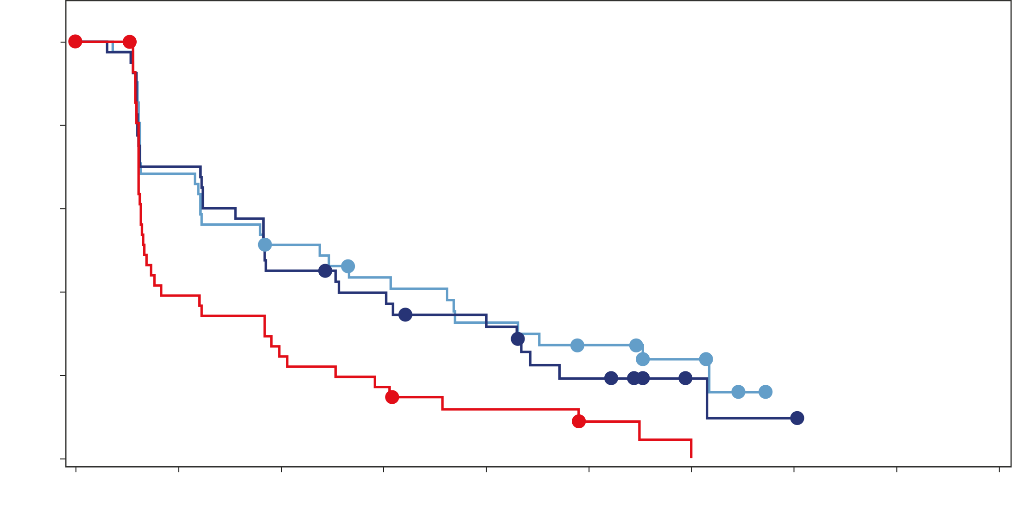
PFS by prior CDK4/6i, and by lung and/or liver metastases
Prior CDK4/6i
Presence of lung and/or liver metastases
​ | C 75 ​(n=38)​ | C​ 150 ​(n=37)​ | F 500 ​(n=37)​
Events [n (%)]​ | 29 (76.3) | 29 (78.4) | 33 (89.2)
Median PFS, months (90% CI)​ | 5.5 (3.7-10.9) | 3.8 (2.0-7.6) | 2.1 (1.9-3.7)
Adjusted HR (90% CI)ª​ | 0.49 (0.31-0.75) | 0.68 (0.44-1.04) | -​
​ | C 75 ​(n=43)​ | C​ 150 ​(n=43)​ | F 500 ​(n=43)​
Events [n (%)]​ | 31 (72.1) | 32 (74.4) | 39 (90.7)
Median PFS, months (90% CI)​ | 7.2 (3.6-11.1) | 5.6 (3.7-9.1) | 2.0 (1.9-3.6)
Adjusted HR (90% CI)ª​ | 0.43 (0.28-0.65) | 0.55 (0.37-0.82) | -​
^{1.0}
^{1.0}
^{0.8}
^{0.8}
^{0.6}
^{0.6}
^{Probability of PFS}
^{Probability of PFS}
^{0.4}
^{0.4}
^{0.2}
^{Camizestrant 75 mg}
^{Camizestrant 150 mg}
^{Fulvestrant 500 mg}
^{0.2}
^{Camizestrant 75 mg}
^{Camizestrant 150 mg}
^{Fulvestrant 500 mg}
^{0.0}
^{0.0}
⁰
³
⁶
⁹
¹²
¹⁵
¹⁸
²¹
²⁴
²⁷
⁰
³
⁶
⁹
¹²
¹⁵
¹⁸
²¹
²⁴
²⁷
^{Time (months)}
^{Time (months)}
C 75 | 38 | 27 | 18 | 15 | 10 | 5 | 2 | 0
C 150 | 37 | 21 | 15 | 11 | 7 | 0
F | 37 | 16 | 8 | 5 | 3 | 1 | 1 | 0
C 75 | 43 | 28 | 20 | 16 | 12 | 9 | 4 | 0
C 150 | 43 | 28 | 18 | 15 | 12 | 6 | 2 | 1 | 0
F | 43 | 16 | 10 | 7 | 4 | 2 | 1 | 0
No prior CDK4/6i therapy: mPFS was 7.2 (90% CI: 3.7–16.6) and 14.7 (5.6–18.4) months with camizestrant 75 and 150 mg, and 9.2 (2.8–14.7) months with fulvestrant (HRª [90% CI]: 0.78 [0.47–1.28] for 75 mg and 0.65 [0.40–1.06)] for 150 mg)
No lung or liver metastases: mPFS was 5.5 (90% CI: 3.7–15.0) and 14.5 (5.6–17.2) months with camizestrant 75 and 150 mg, and 9.2 (3.7–18.7) months with fulvestrant (HRª [90% CI]: 0.99 [0.57–1.69] for 75 mg and 0.91 [0.53–1.56] for 150 mg)
In patients previously treated with CDK4/6i + endocrine therapy, and those with lung and/or liver metastases, camizestrant at both doses produces a clinically meaningful improvement in PFS over fulvestrant​
ªHRs adjusted for liver/lung metastases and prior use of CDK4/6i, respectively
CI: confidence interval; CDK4/6i: CDK4/6 inhibitor; HR: hazard ratio; PFS: progression-free survival

Slide 7
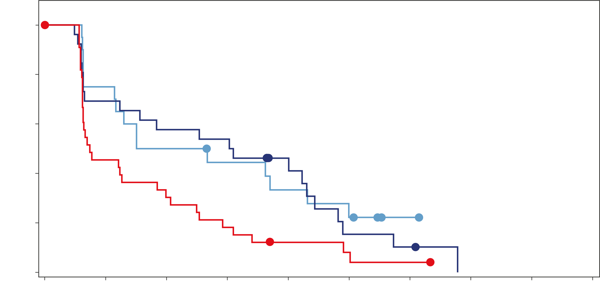
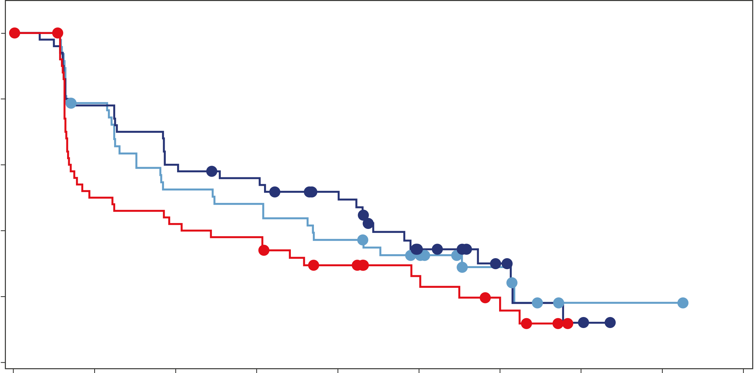
PFS by detectable ESR1m and ER-driven disease*
ESR1m detectable at baseline ​
Patients with evidence of ER-driven disease*
​ | C 75 ​(n=22)​ | C​ 150 ​(n=26)​ | F 500 ​(n=35)​
Events [n (%)]​ | 15 (68.2) | 22 (84.6) | 31 (88.6)
Median PFS, months (90% CI)​ | 6.3 (3.4-12.9) | 9.2 (3.7-12.9)​ | 2.2 (1.9-3.8)
Adjusted HR (90% CI)ª​ | 0.33 (0.18-0.58) | 0.55 (0.33-0.89) | -​
​ | C 75 ​(n=50)​ | C​ 150 ​(n=53)​ | F 500 ​(n=53)​
Events [n (%)]​ | 34 (68.0) | 35 (66.0) | 40 (75.5)
Median PFS, months (90% CI)​ | 7.4 (4.5-11.1) | 12.0 (5.6-14.5) | 3.2 (2.0-7.3)
Adjusted HR (90% CI)ª​ | 0.53 (0.35-0.79) | 0.58 (0.39-0.86) | -
^{1.0}
^{1.0}
^{0.8}
^{0.8}
^{0.6}
^{0.6}
^{Probability of PFS}
^{Probability of PFS}
^{0.4}
^{0.4}
^{0.2}
^{Camizestrant 75 mg}
^{Camizestrant 150 mg}
^{Fulvestrant 500 mg}
^{0.2}
^{Camizestrant 75 mg}
^{Camizestrant 150 mg}
^{Fulvestrant 500 mg}
^{0.0}
^{0.0}
⁰
³
⁶
⁹
¹²
¹⁵
¹⁸
²¹
²⁴
²⁷
⁰
³
⁶
⁹
¹²
¹⁵
¹⁸
²¹
²⁴
²⁷
^{Time (months)}
^{Time (months)}
C 75 | 22 | 15 | 10 | 8 | 6 | 4 | 1 | 0
C 150 | 26 | 18 | 15 | 14 | 9 | 3 | 2 | 0
F | 35 | 15 | 10 | 6 | 3 | 2 | 1 | 0
C 75 | 50 | 36 | 24 | 22 | 17 | 12 | 6 | 1 | 1 | 0
C 150 | 53 | 39 | 30 | 27 | 22 | 11 | 6 | 2 | 0
F | 53 | 25 | 21 | 19 | 12 | 8 | 5 | 0
In the sub-population of patients with detectable ESR1m at baseline, camizestrant at both doses produces a clinically meaningful improvement in PFS over fulvestrant
ESR1m not detectable: mPFS was 7.2 (90% CI: 3.7–10.9) and 5.8 (3.8–14.9) months with camizestrant 75 and 150 mg, and 7.2 (2.0–10.7) months with fulvestrant (HRª [90% CI]: 0.78 [0.50–1.22] for 75 mg and 0.76 [0.48–1.20)] for 150 mg)
In the subgroup of patients with evidence of ER-driven disease (71.3% of overall population), both 75 mg (HR 0.53) and 150 mg (HR 0.58) produced a clinically meaningful PFS improvement over fulvestrant
Without evidence of ER-driven disease: in the (small, 28.7% of overall population) subgroup, 75 mg (HR 0.73) produced a trend to benefit over fulvestrant; the effect for 150 mg (HR 1.01) was less clear
ªHRs adjusted for prior use of CDK4/6i and liver/lung metastases
*Defined in accordance with 5th ESO-ESMO ABC guidelines where the cut-point is increased to 12 months for patients receiving ET+CDK4/6i therapy in the advanced setting
CI: confidence interval; CDK4/6i: CDK4/6 inhibitor; ER: estrogen receptor; ESR1m: mutation in estrogen receptor 1 gene; HR: hazard ratio; PFS: progression-free survival

Slide 8
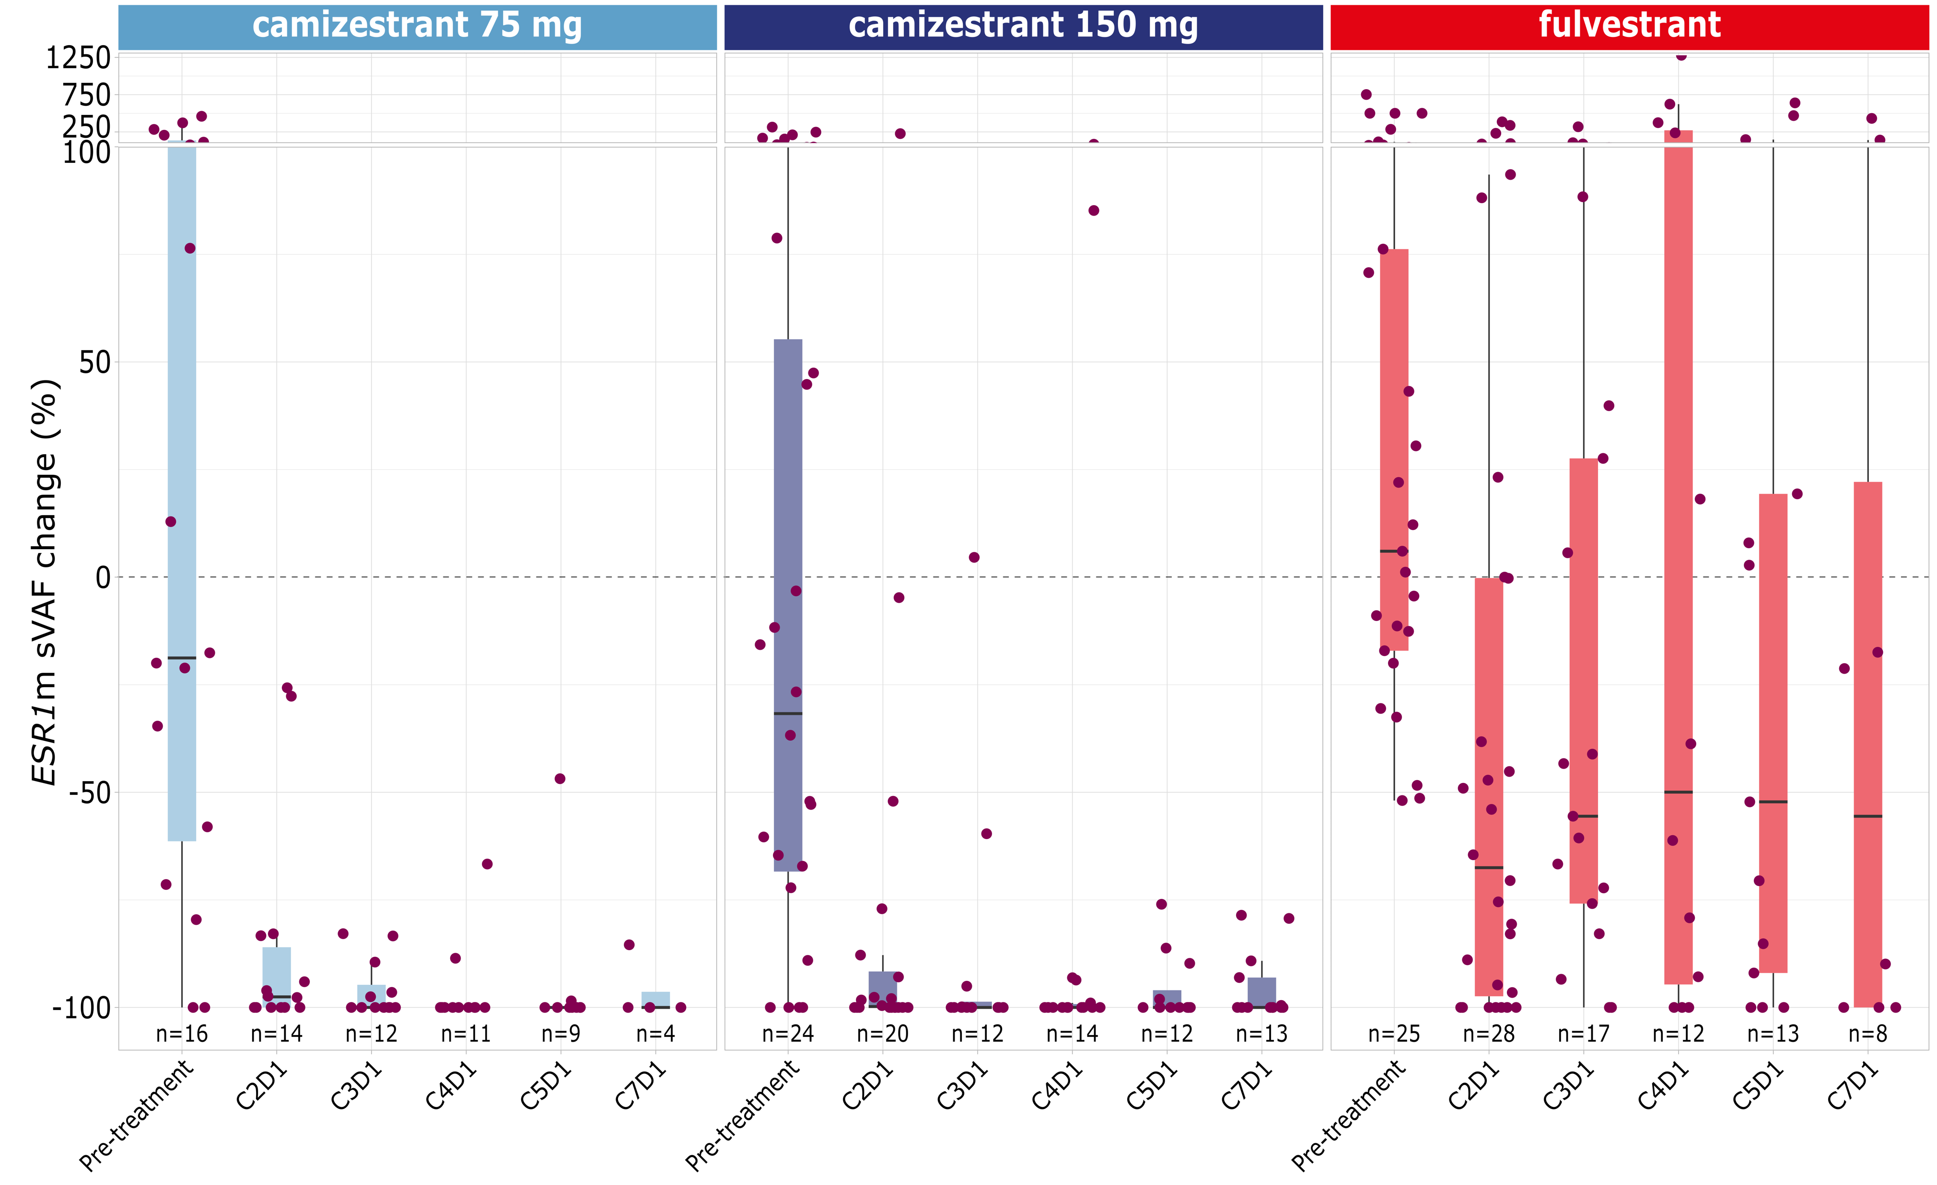
Changes in ESR1m ctDNA variant allele frequency
1250
camizestrant 75 mg
camizestrant 150 mg
fulvestrant
Treatment with camizestrant 75 and 150 mg reduced the level of ESR1m ctDNA to undetectable or near undetectable levels by Cycle 2 Day 1 and maintained this to Cycle 7 Day 1
Fulvestrant also reduced levels of ESR1m ctDNA, but not to the same extent as camizestrant​
750
250
100
50
ESR1m cVAF change (%)
0
-50
-100
n=16
n=14
n=12
n=11
n=9
n=4
n=24
n=20
n=12
n=14
n=12
n=13
n=25
n=28
n=17
n=12
n=13
n=8
C2D1
C3D1
C4D1
C5D1
C7D1
C2D1
C3D1
C4D1
C5D1
C7D1
C2D1
C3D1
C4D1
C5D1
C7D1
Pre-treatment
Pre-treatment
Pre-treatment
ESR1m classed as E380Q, V422del, S463P, L536H/P/R, Y537C/D/N/S, D538G. Pre-treatment = % change in ESR1m sVAF from screening to Cycle 1 Day 1, CXD1 = % change from Cycle 1 Day 1 to Cycle X Day 1​
ctDNA: circulating tumor DNA; ESR1m: mutation in estrogen receptor 1 gene; ESR1m sVAF: Summed variant allele frequency of qualifying ESR1m​

Slide 9
Objective response rate and clinical benefit rate at 24 weeks
Group​ | n​ | Number (%) of patients with response​ | Adjusted response rate (%)​ | Comparison against fulvestrant ​
 |  |  |  | Odds ratio​ | 90% CI​ | 2-sided p-value​
ORR​ | ​ | ​ | ​ | ​ | ​ | ​
Camizestrant 75 mg​ | 70 | 11 (15.7) | 15.7 | 1.43 | 0.63-3.33 | 0.4789
Camizestrant 150 mg​ | 65 | 13 (20.0) | 20.3 | 1.96 | 0.88-4.51 | 0.1675
Fulvestrant ​ | 68 | 8 (11.8) | 11.5
CBR24​ | ​ | ​ | ​ | ​ | ​ | ​
Camizestrant 75 mg​ | 74 | 35 (47.3)​​ | 48.8​​ | 1.48​ | 0.84-2.64​ | 0.2554​
Camizestrant 150 mg​ | 73 | 36 (49.3)​​ | 51.0​​ | 1.62​​ | 0.91-2.89​ | 0.1658​
Fulvestrant ​ | 73 | 28 (38.4)​​ | 39.1​​ | ​​ | ​​ | ​​
The analysis was performed using logistic regression with adjustments for prior use of CDK 4/6 inhibitors and presence of lung and/or liver metastasis. ​​​ Includes unconfirmed responses. Objective response determined for patients with measurable disease only. Clinical benefit defined as patients with best objective response of complete response or partial response in the first 25 weeks or who have stable disease for at least 23 weeks after randomization. ​​​
Camizestrant at 75 and 150 mg increases both ORR and CBR24 over fulvestrant ​
CBR24: clinical benefit rate at 24 weeks; CI confidence interval; ORR: objective response rate

Slide 10
Patient level safety summary
​ | C ​75​ (n=74)​ | C ​150 (n=73)​ | C ​300​ (n=20)​ | F​ 500 (n=73)​
Total duration, months, mean (SD)​ | 8.27 (6.59) | 8.91 (6.78) | 9.26 (8.19) | 7.34 (6.09)
Any treatment-emergent AE (TEAE)​, n (%) | 57 (77.0) | 66 (90.4) | 19 (95.0) | 50 (68.5)
Any treatment-related AE (TRAE)​​, n (%) | 39 (52.7) | 49 (67.1) | 14 (70.0) | 13 (17.8)
CTCAE Grade 3 or higher​​, n (%) | 1 (1.4) | 2 (2.7) | 1 (5.0) | 1 (1.4)
serious​​, n (%) | 3 (4.1) | 2 (2.7) | 1 (5.0) | 0
fatal​ | 0 | 0 | 0 | 0
leading to discontinuation of treatment, n (%)​ | 2 (2.7) | 0 | 0 | 0
TEAE leading to dose reduction​​, n (%) | 1 (1.4) | 9 (12.3) | 4 (20.0) | 0
TEAE leading to dose interruption​, n (%)​ | 11 (14.9) | 16 (21.9) | 4 (20.0) | 3 (4.1)
TRAE leading to dose interruption​​, n (%) | 7 (9.5) | 8 (11.0) | 3 (15.0) | 0
Median duration of dose interruption (days)​ | 7.0 | 7.5 | 7.0 | -
TRAEs of Grade 3 or higher and TRAEs leading to discontinuation were infrequent across all treatment arms​​​
TRAEs leading to dose interruptions were numerically similar for camizestrant 75 and 150 mg, and of short duration​
All camizestrant doses are well tolerated
AE: adverse event; CTCAE: common terminology criteria for adverse events; SD: standard deviation; TEAE: treatment-emergent adverse event; TRAE: treatment-related adverse event

Slide 11
All treatment-emergent adverse events
​ AE, n (%) | C 75 ​(n=74​) |  | C 150​ (n=73​) |  | C 300 (n=20​) |  | F 500 (n=73​)
AE, n (%) | All grades | Grade ≥3 | All grades | Grade ≥3​ | All grades | Grade ≥3 | All grades | Grade ≥3​
Any AE​ | 57 (77.0) | 9 (12.2) | 66 (90.4) | 16 (21.9) | 19 (95.0) | 3 (15) | 50 (68.5) | 10 (13.7)
Photopsia​ | 9 (12.2) | 0 | 18 (24.7) | 0 | 7 (35.0) | 0 | 0 | 0
(Sinus) bradycardia​ | 4 (5.4) | 0 | 19 (26.0) | 0 | 8 (40.0) | 0 | 0 | 0
Fatigue​ | 4 (5.4) | 0 | 13 (17.8) | 1 (1.4) | 4 (20.0) | 0 | 3 (4.1) | 0
Anemia​ | 8 (10.8) | 0 | 11 (15.1) | 1 (1.4) | 1 (5.0) | 0 | 5 (6.8) | 2 (2.7)
Asthenia​ | 6 (8.1) | 0 | 11 (15.1) | 0 | 2 (10.0) | 0 | 4 (5.5) | 0
Arthralgia​ | 3 (4.1) | 0 | 9 (12.3) | 1 (1.4) | 2 (10.0) | 0 | 2 (2.7) | 0
AST increased​ | 2 (2.7) | 0 | 6 (8.2) | 0 | 2 (10.0) | 0 | 5 (6.8) | 1 (1.4)
ALT increased​ | 1 (1.4) | 0 | 6 (8.2) | 1 (1.4) | 3 (15.0) | 0 | 4 (5.5) | 1 (1.4)
Covid-19​ | 4 (5.4) | 0 | 4 (5.5) | 0 | 3 (15.0) | 0 | 3 (4.1) | 0
Diarrhea​ | 4 (5.4) | 0 | 4 (5.5) | 0 | 3 (15.0) | 1 (5.0) | 2 (2.7) | 1 (1.4)
Pain in extremity​ | 1 (1.4) | 0 | 4 (5.5) | 1 (1.4) | 2 (10.0) | 0 | 3 (4.1) | 0
Dyspepsia​ | 1 (1.4) | 0 | 3 (4.1) | 0 | 2 (10.0) | 0 | 1 (1.4) | 0
Insomnia​ | 1 (1.4) | 0 | 3 (4.1) | 0 | 2 (10.0) | 0 | 1 (1.4) | 0
Hyponatremia​ | 0 | 0 | 3 (4.1) | 1 (1.4) | 2 (10.0) | 0 | 1 (1.4) | 1 (1.4)
Blood pressure increased​ | 2 (2.7) | 1 (1.4) | 1 (1.4) | 1 (1.4) | 2 (10.0) | 1 (5.0) | 0 | 0
Cataract​ | 2 (2.7) | 0 | 0 | 0 | 2 (10.0) | 0 | 0 | 0
Vitreous floaters​ | 2 (2.7) | 0 | 0 | 0 | 2 (10.0) | 0 | 0 | 0
Ranked by all grades for the 150 mg dose,​ ≥10% in any arm, irrespective of causality assessment AE: adverse event; ALT: alanine transaminase; AST: aspartate aminotransferase

Slide 12
Conclusions
SERENA-2 met its primary objective: camizestrant at both 75 and 150 mg doses improves PFS over fulvestrant ​in post-menopausal women with ER+/HER2- ABC
Camizestrant delivers statistically significant and clinically meaningful PFS benefit at both 75 and 150 mg doses over fulvestrant in the overall population
A clinically meaningful PFS benefit was observed across the pre-specified subgroups of unmet medical need (post-CDK4/6i, lung/liver metastases, ESR1m and evidence of ER-driven disease)
Both camizestrant doses are well tolerated, with infrequent Grade ≥3 TRAEs, dose reductions and discontinuations
The results of SERENA-2 support the further development of camizestrant in ER+ BC
Recruitment to two Phase 3 studies of camizestrant in ABC, SERENA-4ª and SERENA-6^{b}, continues​
ªSERENA-4 NCT04711252; ^{b}SERENA-6 NCT04964934
ABC: advanced breast cancer; AE: adverse event; CDK4/6i: CDK4/6 inhibitor; ER: estrogen receptor; ESR1m: mutation in estrogen receptor 1 gene; HER2: human epidermal growth factor receptor 2; PFS: progression-free survival; TRAE: treatment-related adverse event

Slide 13
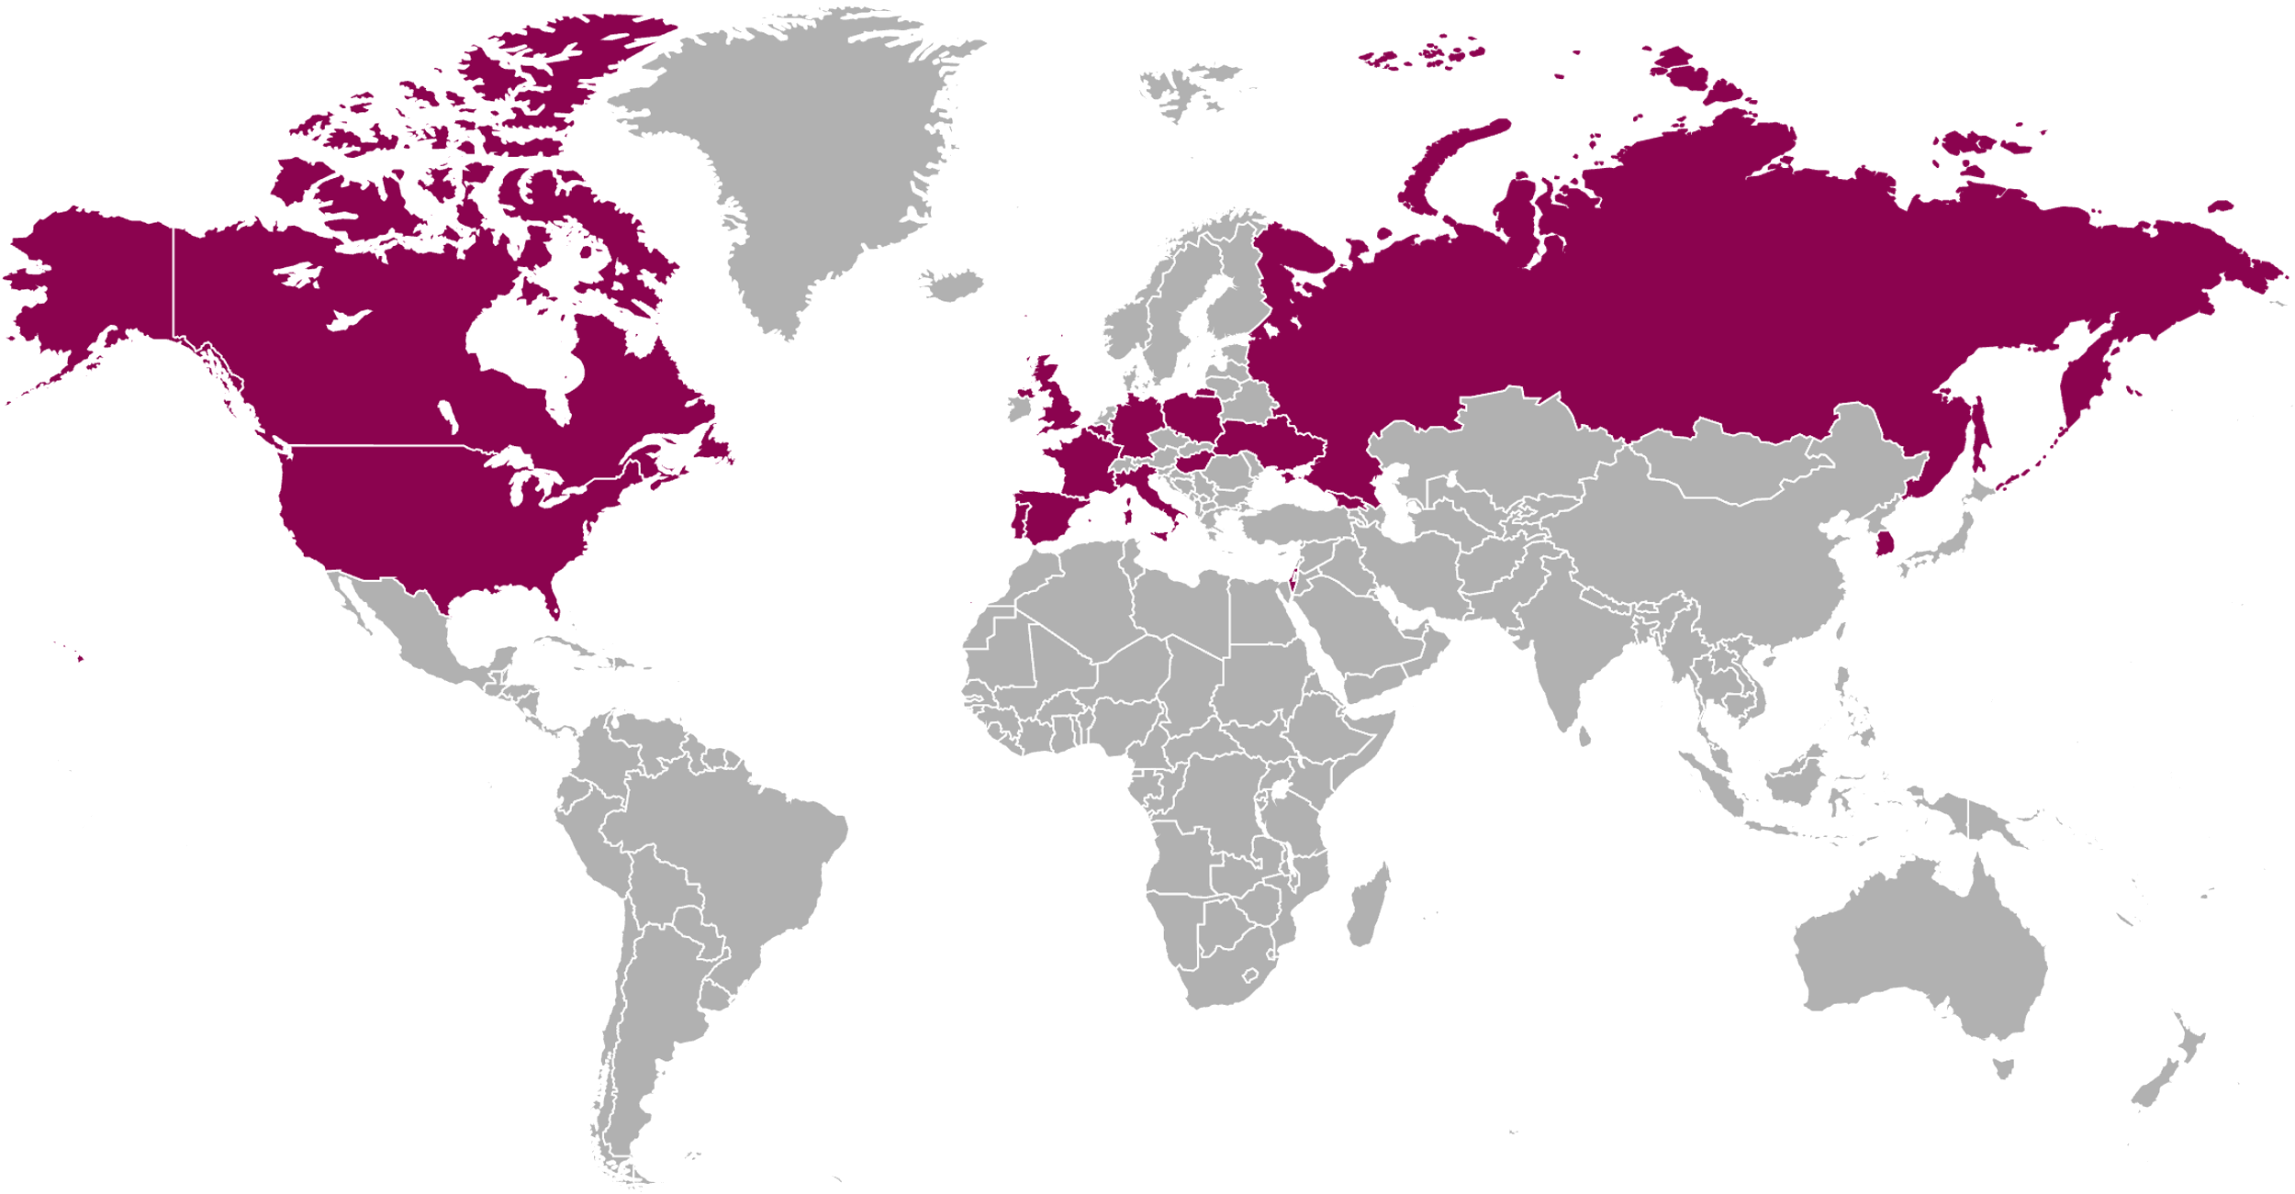
Acknowledgements
The study was sponsored by AstraZeneca
Our deepest gratitude is extended to the patients and their families for their participation
We sincerely thank all the investigators and site staff for their contribution
Please scan this QR code to view a plain language summary
Russian Federation
Canada
Germany
Belgium
United Kingdom
France
South Korea
United States
Portugal
Ukraine
Spain
Italy
Poland
Israel
Georgia
Hungary

